Slide 1
Design and Applications of Direct-Digital VFOs
By James D. Hagerty

Slide 2
What is DDS?
Generates a waveform using digital hardware building blocks. The DDS output frequency is referenced to a high-stability clock signal (user-provided). Avoids L’s and C’s!
Change frequency “on the fly” by serially loading 32-bit binary numbers into the chip
High degree of accuracy and software flexibility; control with a microprocessor or PC

Slide 3
Simple DDS Architectures
Most Basic Configuration: Clocked Lookup
Table (Addresses Memory with Stored Values)
Clock
Signal
Address Counter
Table of Sampled Sine Values
Clocked Register
Fc
N Bits
D/A
Converter
Fout
From, “A Technical Tutorial on Digital Signal Synthesis,” Analog Devices, C. 1999.

Slide 4
More Flexible DDS (adds a phase accumulator)
PHASE ACCUMULATOR
Phase Register
Phase-to-
Amplitude
Converter
Tuning
Word
D/A Converter
Fout
Summer
32 bits
Data
Bus 16 bits
Data
Bus 16 bits
Data
Bus 16 bits
System Clock
From: “A Technical Tutorial on Digital Signal Synthesis,” Analog Devices, C. 1999.

Slide 5
Direct-Digital VFO
System Architecture (May 2008 QEX)
Master Clock
AD9951 DDS
30 MHz
LPF
30 MHz LPF
Fout
20 dB
100-150 MHz
0.5 volts peak @ 50 ohms
Control Signals
Microprocessor
DISPLAY
Shaft Encoder
Switch Closures (CAL, RIT, Memory, SAVE, Offset, etc.)

Slide 6
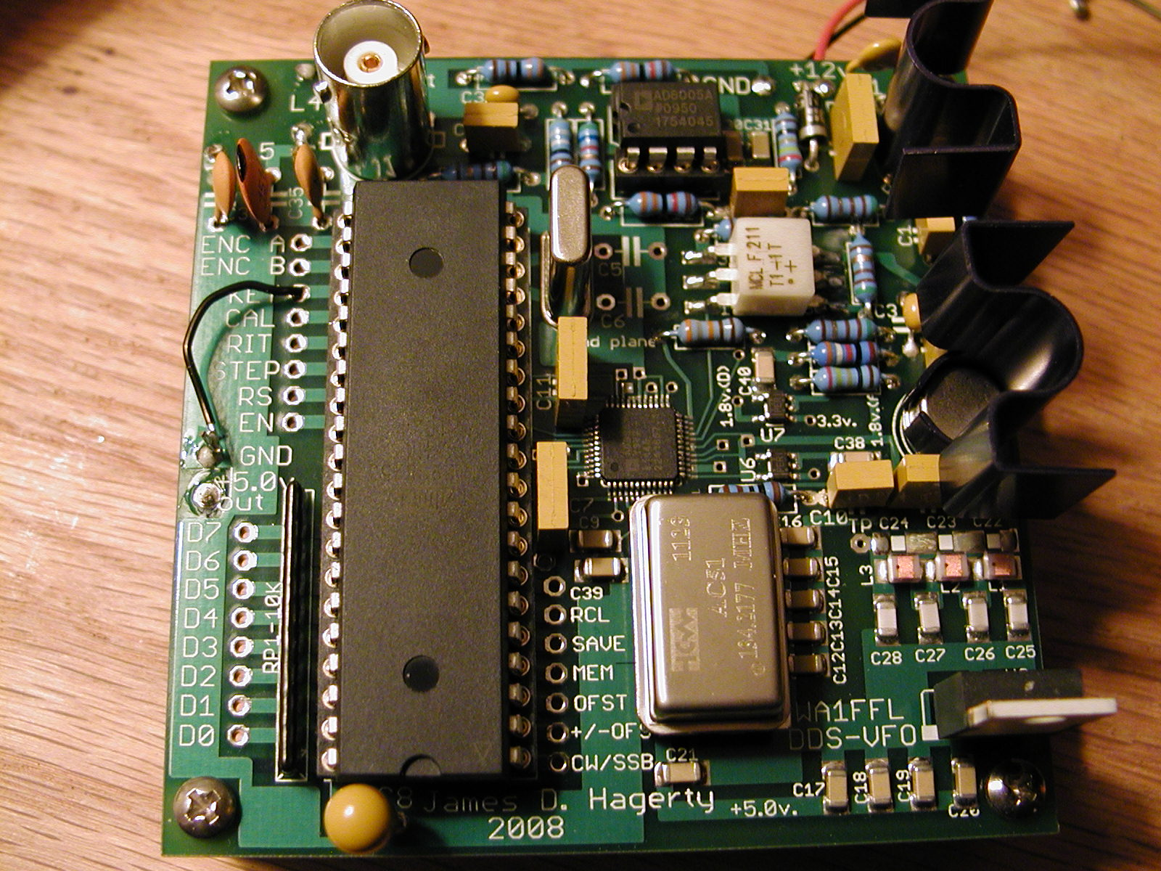
WA1FFL DDS VFO board

Slide 7
DDS Control Signals
CONTROL FLOW
PowerDownCtrl
Reset
OSK
DATA
SDIO
Data Clock
SCLK
Data Start/Stop
I/O Update
Microprocessor
DDS

Slide 8
Shaft Encoder Timing
Grayhill, Bournes, etc. shaft encoder pulses
CHANNEL A
“1”
“1”
“0”
“0”
“1”
“0”
“1”
“1”
“0”
“0”
CHANNEL B
Quadrature 2-bit codes;
Channel A leads
Channel B by 90 degrees
ONE CYCLE

Slide 9
Frequency Tuning Word
32-bit fixed-point integer stored in hexadecimal (base-16!) format.
Ftune= {(2**32)/Fclock} * Fout ; “Master Equation!”
Example: for a 7 MHz output, Ftune =
{(4.295 x 10E9) /150 MHz} x 7 MHz =
200.431 E6 (base 10) = BF258BF in hex (base 16)
Note: if Fclock= 134.217728 MHz, coefficients
are perfect integers (no rounding/truncation error!).

Slide 10
DDS Clock Signal
Typically 100-150 MHz for the AD9951
Can use clock multiplier (internal (x 4) to (x 20) PLL in chip); generate up to 144 MHz signal!
Clock multiplier gives higher clock to carrier ratio at the expense of phase noise.
AD9951 rated for a 400 MHz clock rate, but will reliably clock at 500 MHz (proto running at 536.87 MHz!); can generate VHF signals
Clock signal should be stable, and as spectrally pure as possible. 25-50 ppm most common
Avoid multipliers inside the clock itself; extra phase noise! See photo.

Slide 11
Phase Noise
The single most important parameter limiting weak-signal communications: (Hayward, Rohde, etc.)
Close-in time-domain jitter produces adjacent sideband energy that is very hard to filter out.
Specified as dBc (dB down from the carrier level) at a reference carrier frequency
Often specified 10 kHz away from the carrier
Typical commercial local oscillator: (-130 to
(-140 dBc) phase noise levels (see Sherwood Engineering web site for typical specs)

Slide 12
Composite Noise Plot

Slide 13
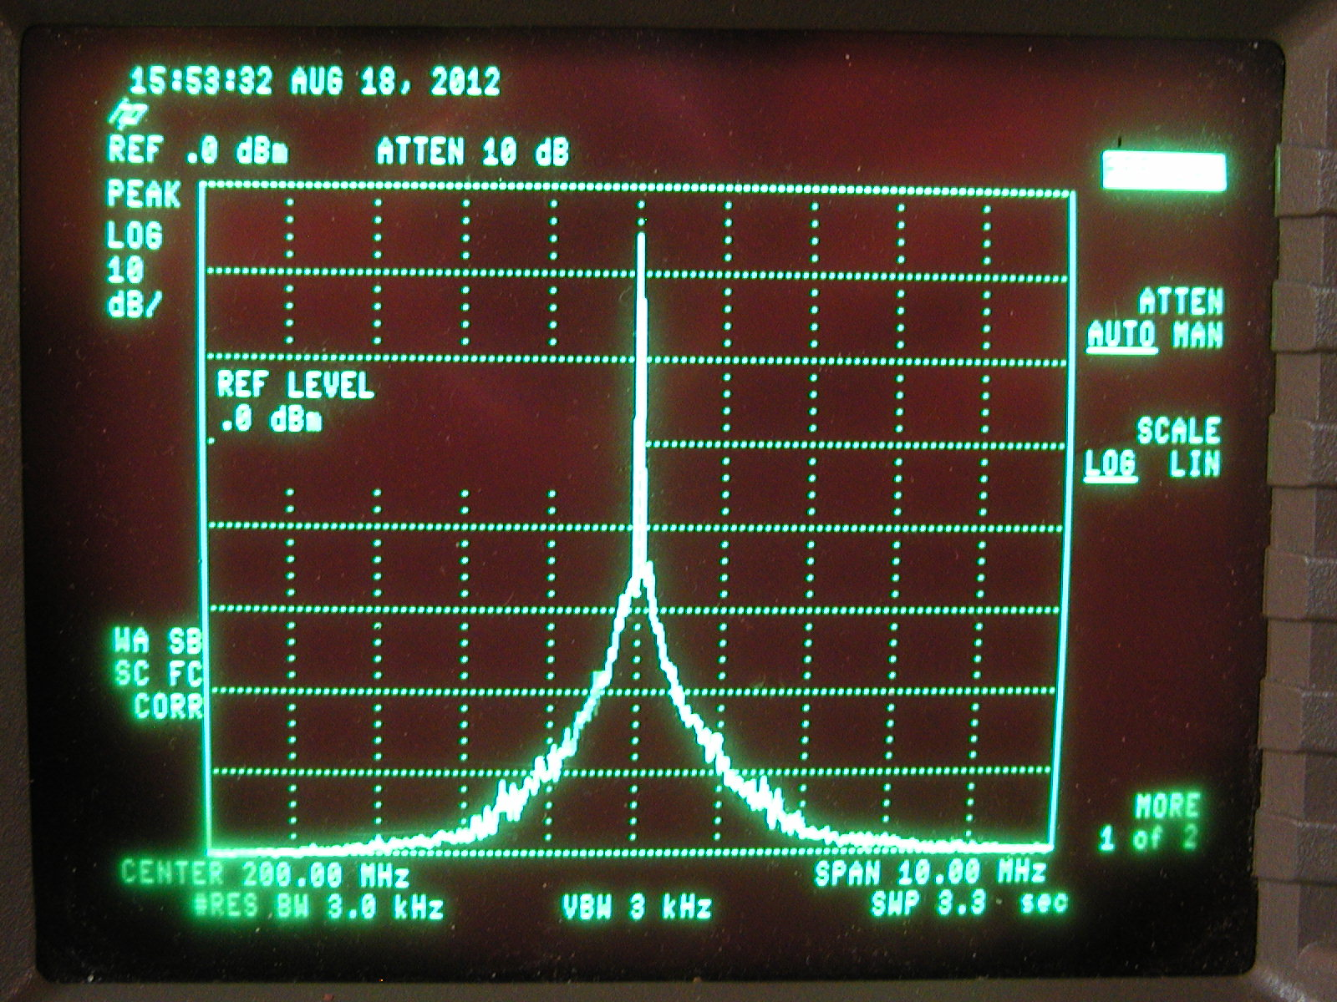
Noisy DDS Clock Oscillator

Slide 14
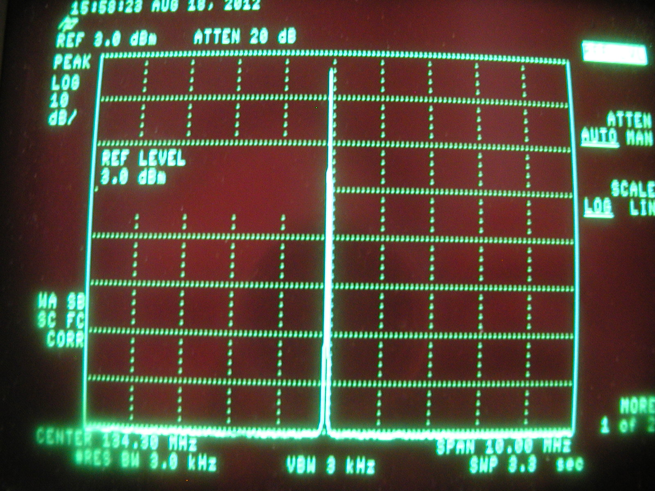
Low-Noise Clock Oscillator (134 MHz)

Slide 15
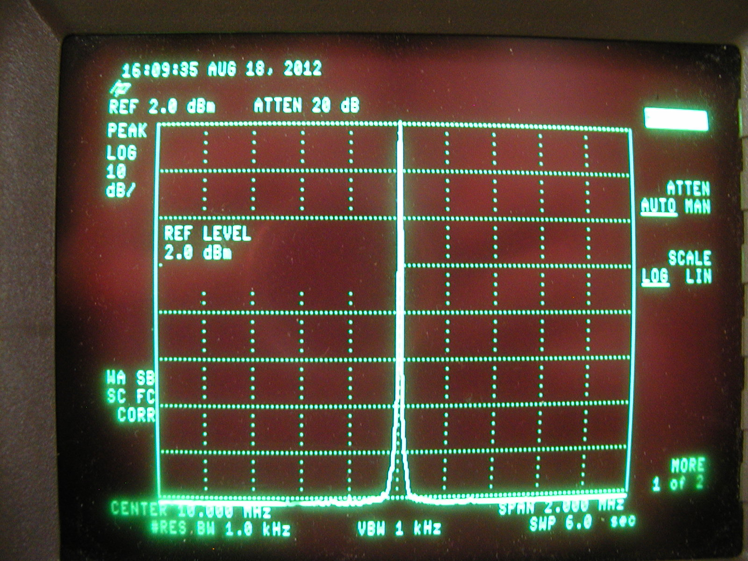
10 MHz Carrier Output

Slide 16
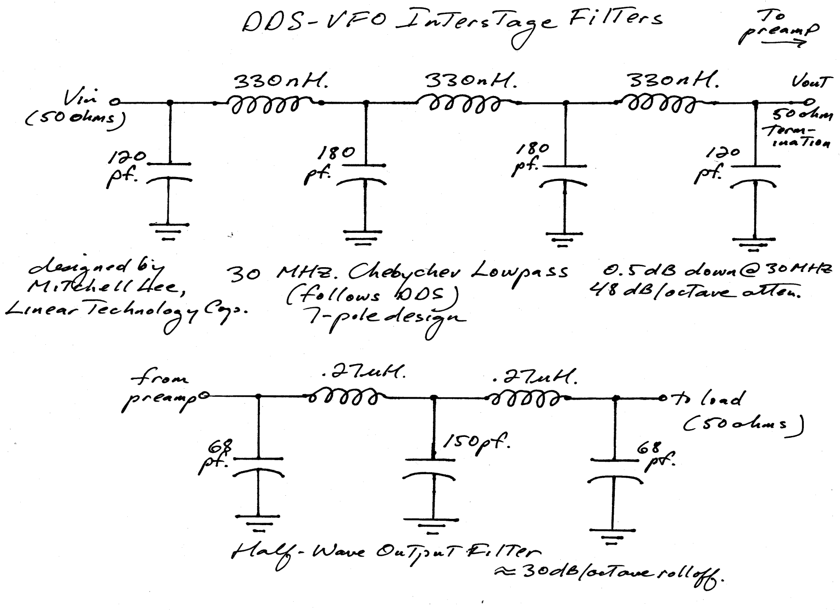
Filters (Removes Clock Noise and Spurious Energy)

Slide 17
Important Features
CAL- freezes display and adds or subtracts 1 Hz steps to frequency register; can then save in
flash memory.
RIT: tunes plus/minus 10 kHz of displayed carrier in 10 Hz steps. Can save in EEPROM.
Memory channels: 16/expandable to 32; saves all frequency settings including RIT
Offset: Two offsets, plus or minus, ON/OFF

Slide 18
PC Layout
Want to separate noisy digital circuitry from low-noise analog portion; Where Do the Currents Flow?
Keep leads as short and direct as possible
Use as few vias as possible, especially in high-speed lines (can act as VHF tank circuits!)
Separate analog and digital planes, connected at edge of card (multiple PCB layers)
Can use digital decouplers (ADUM1100) to break noisy circuit paths (i.e., microprocessor crystal!)
Re. Silicon Labs Application Note AN203

Slide 19
APPLICATIONS IDEAS
Rotary-Switched Band Switched DDS VFO
Driving a “Boat Anchor” Tube Rig
Other Topics of Interest

Slide 20
Rotary Band-Switched DDS
DDS Control
Lines
Band
Switch
74HC147
Priority
Encoder
Micro-processor
4-bit digital word
Encoder Inputs Pulled Up To +5 volts (via pullup resistors)

Slide 21
Driving a “Boat Anchor”
Mostly an Impedance-Matching Problem
Need Volts, as Opposed to “Watts”
Need High Output Impedance Driver
High Output Impedance Makes Driver More Sensitive to Cable Loading
Grid Circuit Can Become Non-Linear; Assume At Least Several K-Ohms of Grid Input Impedance for Practical Circuits
Must Preserve Loaded Stability of Drive Amplifier

Slide 22
“Boat Anchor Driver”
Published in June 2011 CQ; Available on www.WA1FFL.com
VFO Drive (0.5
Volts peak)
To Grid, 10-16 volts
peak
Hi-Z
50 Ohms Z
LT1227 RF op amp
2N3866
1:4 Broadband
Transformer

Slide 23
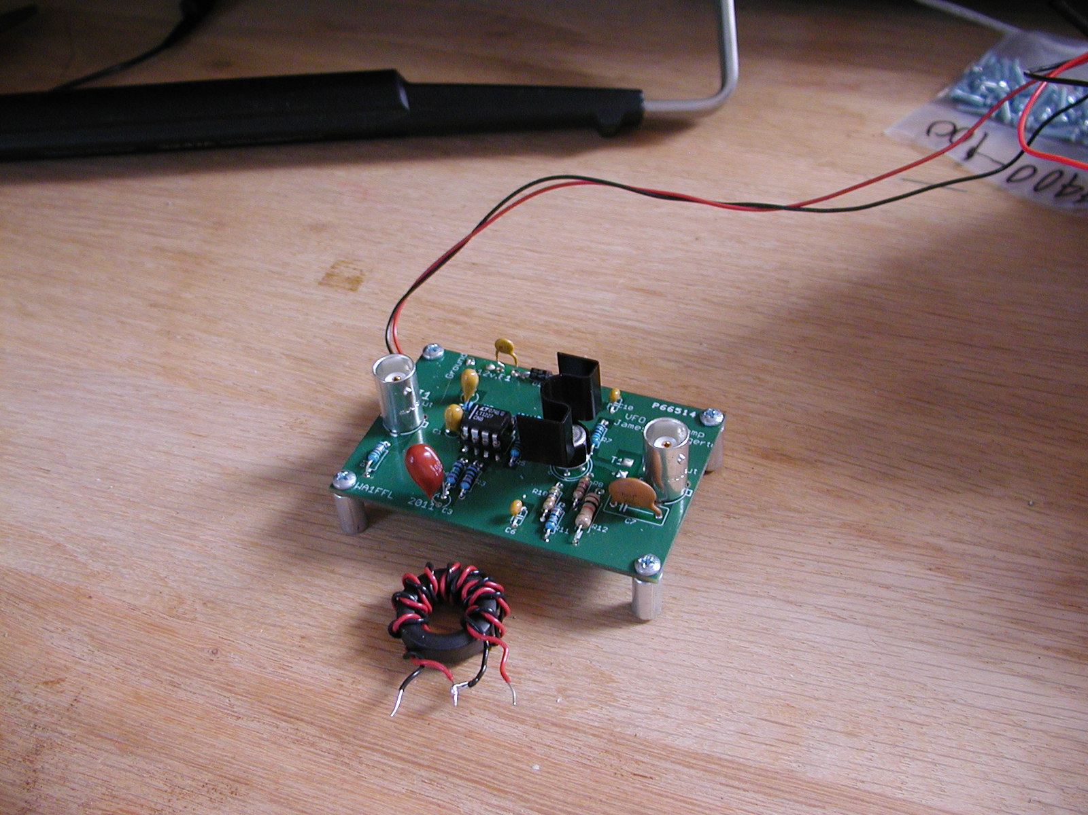
Buffer Amp (2” x 3”) board

Slide 24
“Boat Anchors” driven by WA1FFL buffer amp
DX-40, DX-60
HT-40
Harvey-Wells Bandmaster
Globe Scout
Valiant 1
Knight T-60
QRP “Glowplug”
Millen 90800
Central Electric Exciter
Drake 2-NT
Can Also Drive Johnson Adventurer & Challenger

Slide 25
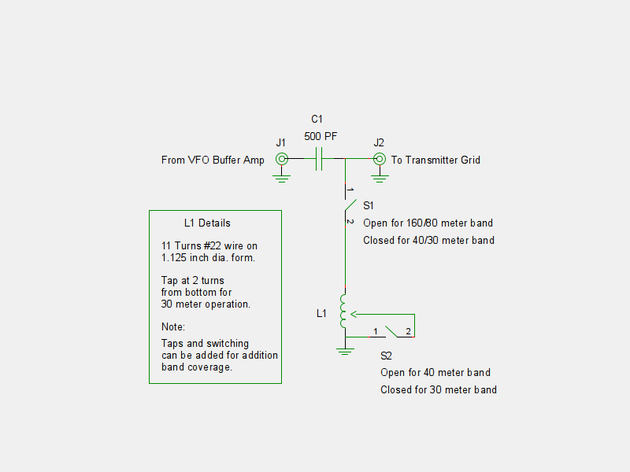
KB3KJS’s “L” Matching Network for driving Ameco copy

Slide 26
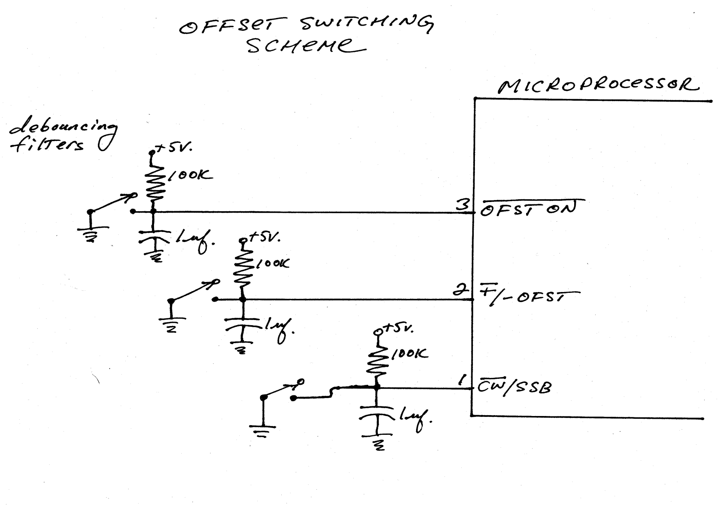
Offset Generation (455 kHz, 10.7 MHz, 700 Hz, etc.)

Slide 27
Other Topics
Analog Devices Evaluation Boards
AD9854-EVB, AD9954-EVB (has I and Q outputs); control via PC interface for experimentation
New DDS chips: 1-3 GHZ clock rate (AD9910, AD9912, etc.) evaluation boards available; must use clock multiplier! Data sheets now available.
Digital FM Sweep (logic circuit to mimic shaft encoder)

